Slide 1
Visualizing Lake Fred
Mohammed Mowla

Slide 2
Agenda
1 – Data Processing
2 – Creating the Model
3 – 3D Printing
4 – Website

Slide 3
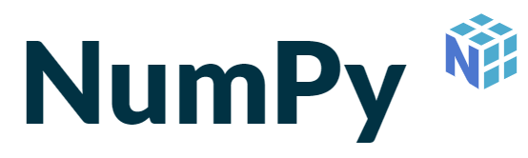

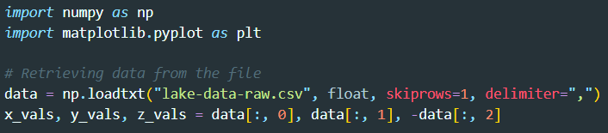
Data Processing
Generating data that is usable in blender

Slide 4
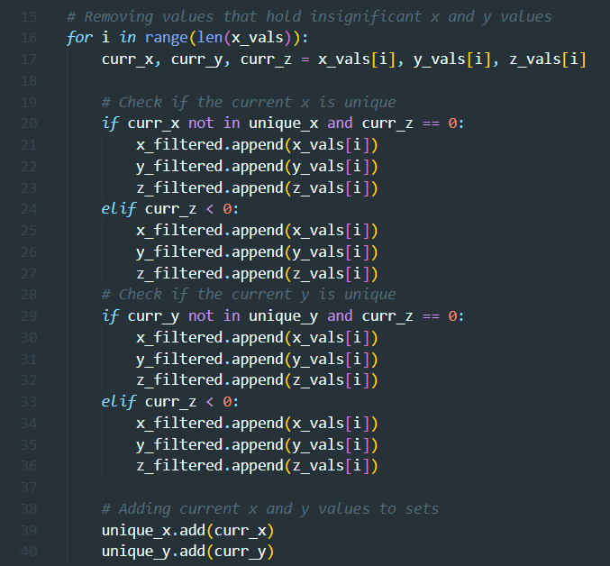
Data Processing
Python
Libraries NumPy and Matplotlib
Data retrieved from Vernier LabQuest 3 as a CSV (Comma Separated Value) file
Multiple Assignments

Slide 5
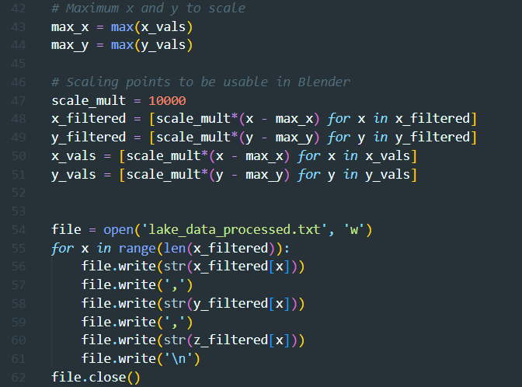
Data Processing (Cont.)
Filtering non-unique x and y values
A set in Python holds only unique values
Ex Array: [11, 41, 53, 22, 11]
Ex Set: {11, 41, 53, 22}

Slide 6
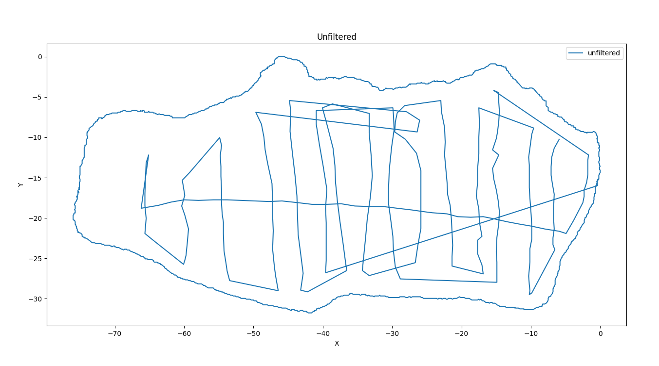

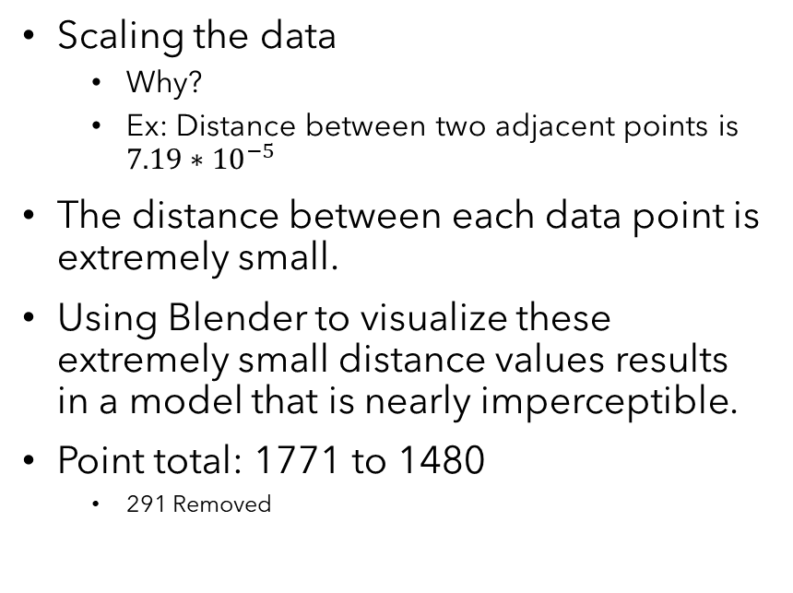
Data Processing (Cont.)
Scaling the data
Why?
Ex: Distance between two adjacent points is $7.19∗{10}^{−5}$
The distance between each data point is extremely small.
Using Blender to visualize these extremely small distance values results in a model that is nearly imperceptible.
Point total: 1771 to 1480
291 Removed

Slide 7
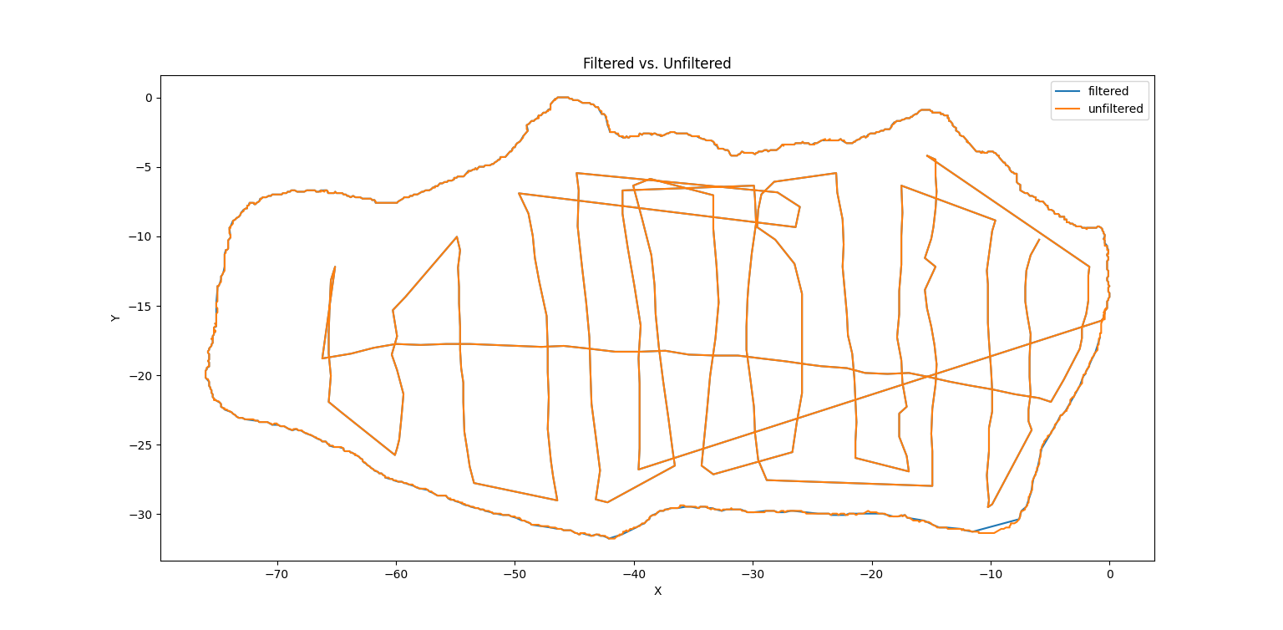
Data Processing Results

Slide 8
Data Processing Results (Cont.)

Slide 9
Creating the Model
Creating the 3D model in Blender Using Delaunay Triangulation

Slide 10
Creating the Model : Blender
Blender is an open-source 3D computer software tool
Supports modeling, rigging, animation, simulations, rendering,…
Includes scripting through Python!
The most obvious use case for blender is to create 3D models for video games.
There are scientific use cases and libraries in Blender
Ex: BlenderGIS
Easily import (satellite) maps, displacement maps and geometry like buildings

Slide 11
How Do You Make a 3D Model?
Identified that we have a point cloud (A discrete set of data points in 3D space)
How do we take a point cloud and make something from it?
Triangulation!

Slide 12
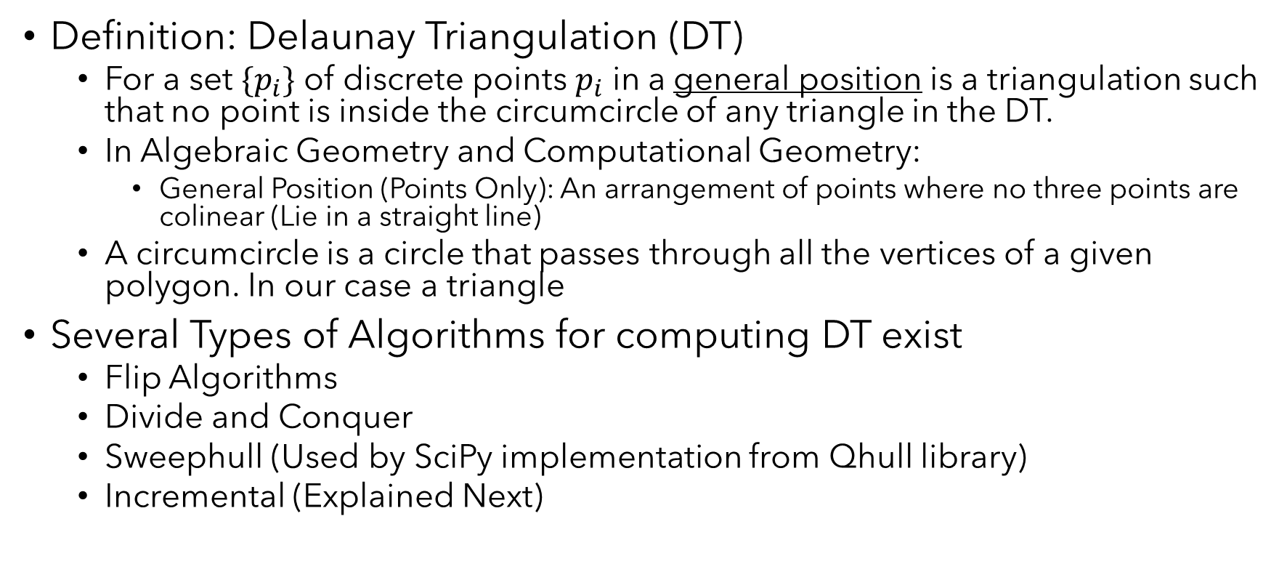
Delaunay Triangulation
Definition: Delaunay Triangulation (DT)
For a set ${\{p}_{i}\}$ of discrete points $p_{i}$ in a general position is a triangulation such that no point is inside the circumcircle of any triangle in the DT.
In Algebraic Geometry and Computational Geometry:
General Position (Points Only): An arrangement of points where no three points are colinear (Lie in a straight line)
A circumcircle is a circle that passes through all the vertices of a given polygon. In our case a triangle
Several Types of Algorithms for computing DT exist
Flip Algorithms
Divide and Conquer
Sweephull (Used by SciPy implementation from Qhull library)
Incremental (Explained Next)

Slide 13
Incremental DT : Bowyer-Watson Algorithm
Let’s look at 4 points
Create a super-triangle the contains all points
Then add one point at a time.
Check to see if a point lies inside another circumcircle
Final Result: Remove triangles that share two or more vertices with the original super-triangle.

Slide 14
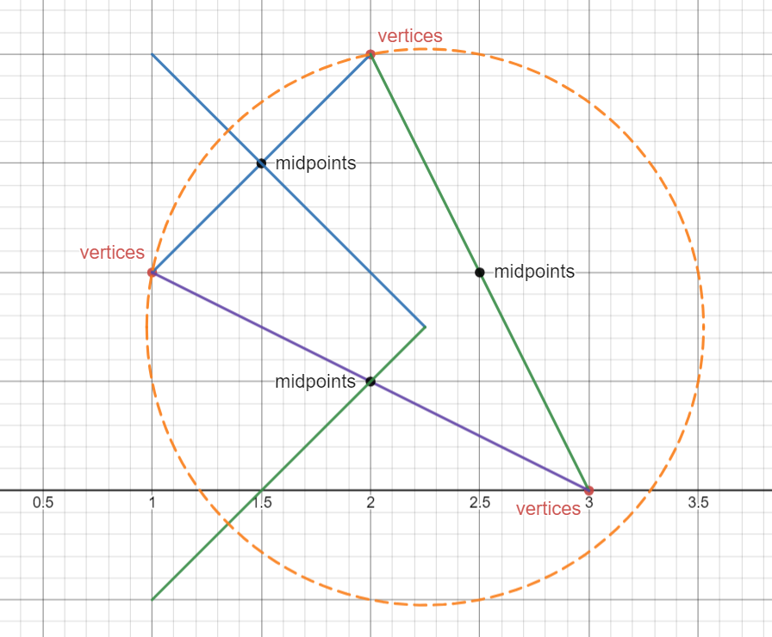
Bowyer-Watson Algorithm (Cont.)
Continue adding points and checking if points lie inside circumcircles to which they don’t belong
Final Result: Remove triangles that share vertices with the original super-triangle

Slide 15
Bowyer-Watson Algorithm (Cont.)
Now how would you implement this in a computer algorithm?
It’s obvious how you see which points lie inside a circumcircle but, how do you figure that out algebraically / programmatically?
There are two approaches to solving this problem.
First approach: Find the intersection of the lines that are perpendicular to the midpoint of the sides of the triangle.
Final Result: Remove triangles that share two or more vertices with the original super-triangle.

Slide 16
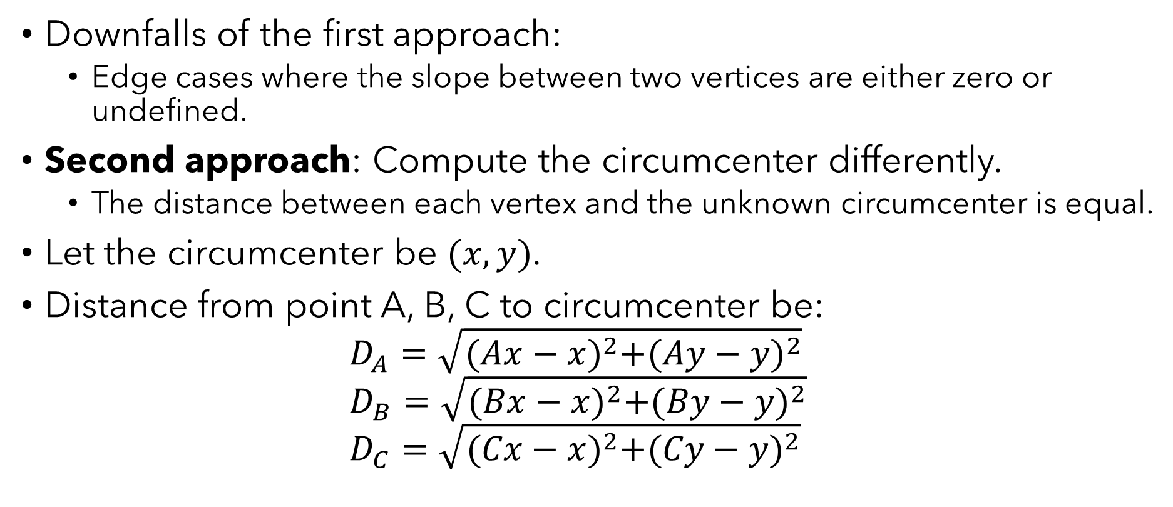
Bowyer-Watson Algorithm (Cont.)
Downfalls of the first approach:
Edge cases where the slope between two vertices are either zero or undefined.
Second approach: Compute the circumcenter differently.
The distance between each vertex and the unknown circumcenter is equal.
Let the circumcenter be $(x,y)$.
Distance from point A, B, C to circumcenter be: $D_{A}=\sqrt{{(Ax−x)}^{2}+{(Ay−y)}^{2}}$ $D_{B}=\sqrt{{(Bx−x)}^{2}+{(By−y)}^{2}}$ $D_{C}=\sqrt{{(Cx−x)}^{2}+{(Cy−y)}^{2}}$
Note: Here Ax, Bx, Cx are all knowns

Slide 17

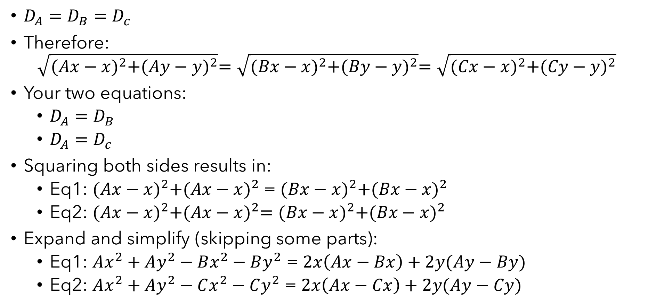
Bowyer-Watson Algorithm (Cont.)
${D_{A}=D}_{B}=$ $D_{c}$
Therefore: $\sqrt{{(Ax−x)}^{2}+{(Ay−y)}^{2}}=\sqrt{{(Bx−x)}^{2}+{(By−y)}^{2}}=\sqrt{{(Cx−x)}^{2}+{(Cy−y)}^{2}}$
Your two equations:
${D_{A}=D}_{B}$
${D_{A}=D}_{c}$
Squaring both sides results in:
Eq1: ${(Ax−x)}^{2}+{(Ax−x)}^{2}$ = ${(Bx−x)}^{2}+{(Bx−x)}^{2}$
Eq2: ${(Ax−x)}^{2}+{(Ax−x)}^{2}={(Bx−x)}^{2}+{(Bx−x)}^{2}$
Expand and simplify (skipping some parts):
Eq1: $Ax^{2}+Ay^{2}−Bx^{2}−By^{2}$ = $2x\left(Ax−Bx\right)+2y(Ay−By)$
Eq2: $Ax^{2}+Ay^{2}−Cx^{2}−Cy^{2}$ = $2x\left(Ax−Cx\right)+2y(Ay−Cy)$

Slide 18

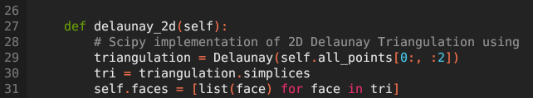
SciPy Implementation of Delaunay Triangulation
Several Types of Algorithms for computing DT exist
Flip Algorithms
Divide and Conquer
Sweephull (Used by SciPy implementation from Qhull library)
Incremental (Explained Previously)
The SciPy implementation is what was used to create the model.

Slide 19
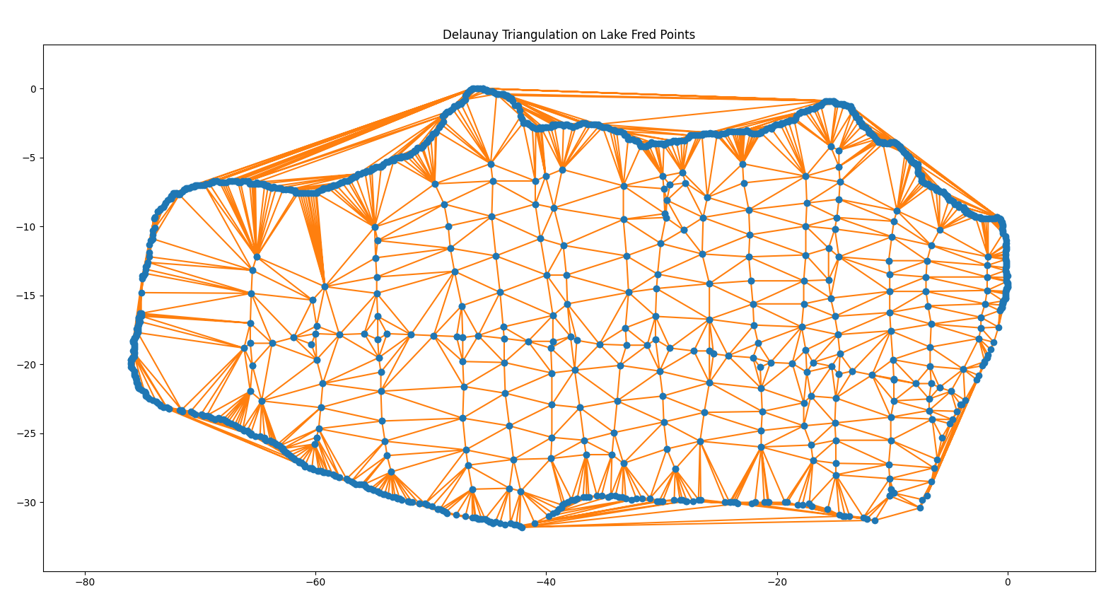
Creating the Model in Blender
Blender has an embedded Python interpreter.
Blender also includes an interface for writing your scripts inside the application
The Meat and Potatoes of the code:

Slide 20
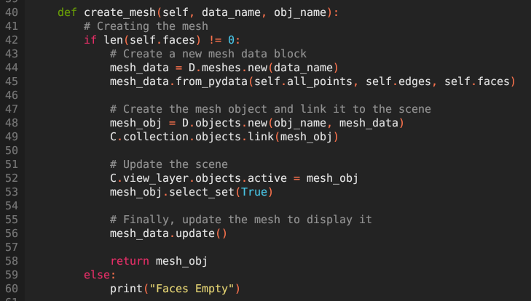
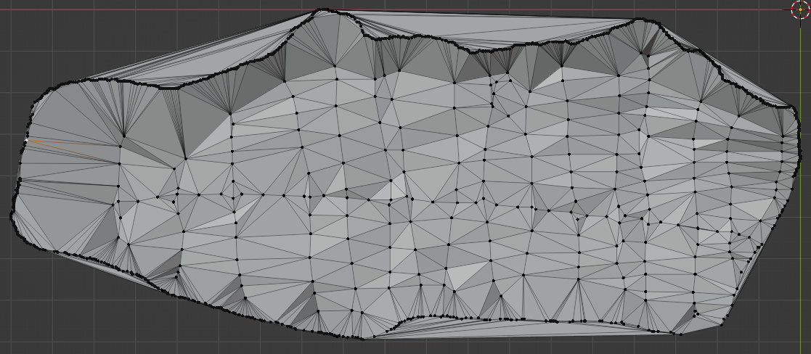
Creating the Model in Blender (Cont.)
Visualizing what SciPy is did:

Slide 21
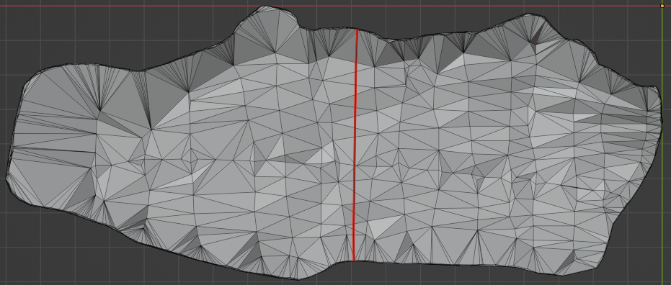
Creating the Model in Blender (Cont.)
Raised / lowered each point in Blender while keeping the same edges:

Slide 22
Creating the Model in Blender (Cont.)
Removed unwanted triangles around perimeter

Slide 23
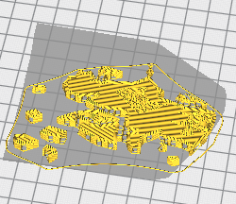
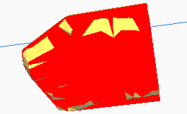
3D Printing
Printing the Model and Associated Issues

Slide 24
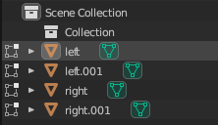
Issues With 3D Printing
Exporting the entire lake model works perfectly fine, great even.
Issues arise when wanting to create a larger model by splitting the lake.
Extruding then exporting caused red error in slicer.
Split results in failed slice

Slide 25
Issues With 3D Printing (Cont.)
Solution: Extrude all four parts
Splitting
Extruding the left and right splits in both up and down extrusions
End result is 4 objects in blender
The blender objects representing 2 left extrusions (up and down) and 2 right extrusions (up and down)

Slide 26
Final 3D Prints
Handing out

Slide 27
Lake Website
View the Lake Model in a browser using Three.js

Slide 28

What is Three.js?
https://collyz.github.io/Personal-Website/ Lake Website
Three.js is a 3D JavaScript library that tries to make it as easy as possible to put 3D content on the web.
WebGL is not the same as Three.js.
WebGL is a very low-level system that only draws points, lights and triangles.
Three.js uses WebGL to do quite a few things but also handles other things such as lights, materials, textures among the many things it can do.

Slide 29
Sources
Qhull - http://www.qhull.org/
An implementation of Watson’s Algorithm for computing 2-Dimensional Delaunay Triangulations [Sloan, Houlsby] https://www.newcastle.edu.au/__data/assets/pdf_file/0018/22482/07_An-implementation-of-Watsons-algorithm-for-computing-two-dimensional-Delaunay-triangulations.pdf

Slide 30

Thank you
Mohammed Mowla
mowlam1@go.stockton.edu
Data Processing, 3D Print and Blender Files
Interactive Lake Fred

